Slide 1
Networked Systems and Applications
(EENGM0009)
George Oikonomou
Room MVB 5.09
g.oikonomou@bristol.ac.uk
(Some original slides by Dr Dritan Kaleshi)

Slide 2
Background Information
Ran 2014-15 for the first time
Some changes to the material in 2018-19
Lecturer: Dr George Oikonomou
Contact:
Email: g.oikonomou@bristol.ac.uk
Office: MVB Room 5.09

Slide 3
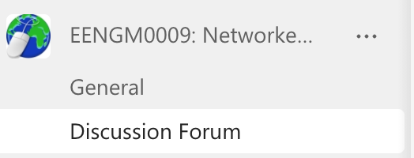
Delivery
MS Team: Non-members can contact me
Discussion Forum channel

Slide 4
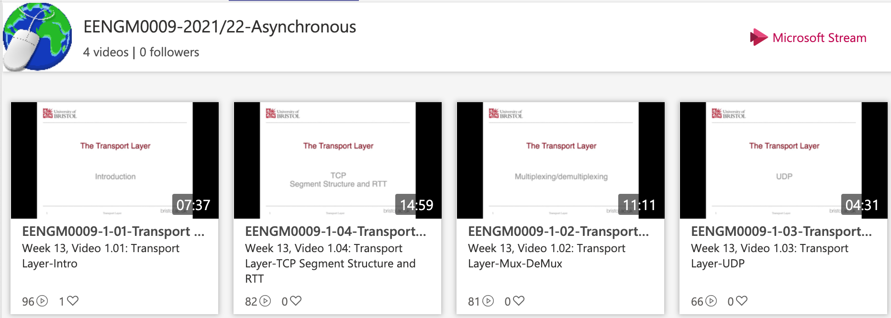
Recordings
Video channels on Stream:
EENGM0009-2021/22-Asynchronous
EENGM0009-2021/22-Synch

Slide 5
Blackboard
“Live sessions”:
Weekly session slides
“Weeks 13 – 17”: Information on what to do when
"Assessment, submission and feedback”
Self-assessment, instant-feedback quizzes
The summer exam

Slide 6
Assessment
100% Exam – Likely online/open-book
Exact rules to be finalised

Slide 7
What are we doing here?
Who are you in this unit?
Application developer/programmer
List services the application needs: guaranteed delivery, low/high delay, no jitter?
Network designer
Designing network to deliver network services cost-effectively, use resources efficiently and be fair to all users
Network provider
Look for your system to be easy to manage and administer, account for the network usage, be able to detect faults and recover.
Notes:
Peterson pp 10-30

Slide 8
Unit Content
Transport Layer Topics
Application Layer Topics
Selected Topics on the Internet of Things

Slide 9
Unit Content
1. Transport Layer Topics
MUXing / DeMUXing
UDP
TCP
Performance calculations
Fairness

Slide 10
Unit Content
2. The Application Layer
Distributed Systems Models and Applications
Classification of interaction models (request/response, pub/sub, RPC)
Network support services (DNS)
Web and HTTP

Slide 11
Unit Content
3. Selected Topics on the IoT
The IEEE 802.15.4 Standard
6LoWPAN: IPv6 over Low power WPAN
RPL: Routing Protocol for Low-Power, Lossy Networks
MQTT Historically “Message Queuing Telemetry Transport”
CoAP: The Constrained Application Protocol

